Slide 1


Florence Airbnb Data Analysis
DSBDA project
Francesco Malaspina
Xixelloje Leka
Hamid Gazerpour

Slide 2
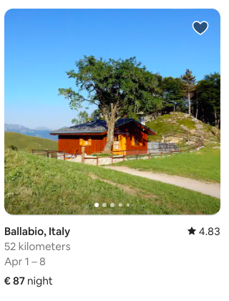
Introduction
The goal of our project is to help Airbnb listings owners and users understand the platform trends. So we:
studied bookings temporal trends
studied temporal recurrencies in price variations
studied how prices are correlated with review scores
Notes:
(seasonality)

Slide 3
Dataset
We analyzed a part of the AirBnb dataset, available on the website http://insideairbnb.com/get-the-data/ and licenced under a Creative Commons Attribution 4.0 International License (http://creativecommons.org/licenses/by/4.0/).
For every city (we choose Florence) 3 main csv files were provided:
listings.csv: Detailed listings data showing 96 attributes, e.g.: price, listing_type, is_superhost, neighbourhood, ratings, …
reviews.csv: Detailed reviews data with 6 attributes: date, listing_id, reviewer_id, comment…
calendar.csv: booking plan for next year by listing. 6 attributes: listing_id, date, available, price, min_nights, max_nights.

Slide 4
Additional datasets
For every city the website provided also a few additional datasets:
listings_summary.csv: contains cleaned (preprocessed) listings data;
review_dates.csv: contains only the review_id and the date;
We assumed that these datasets are not available in the production phase, but that they are available in the sandbox environment.
When scaling to Big Data we derived any useful feature from the original datasets, using Big Data tools.

Slide 5
Architecture for Big Data Management
data lake
data warehouse
BD source:
Airbnb
Spark Streaming
First repository:
Mongo DB
Spark- mongoDB connector
big data analysis:
MapReduce, hive, Spark
Hive
database
long term storage of structured data (hive tables) on HDFS
streaming source of semi-structured data
real time access to new semi-structured data
Sandbox: Florence
std python analysis:
pandas, Scikit learn,
seaborn, matplotlib

Slide 6
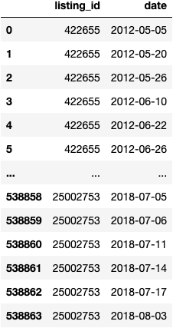
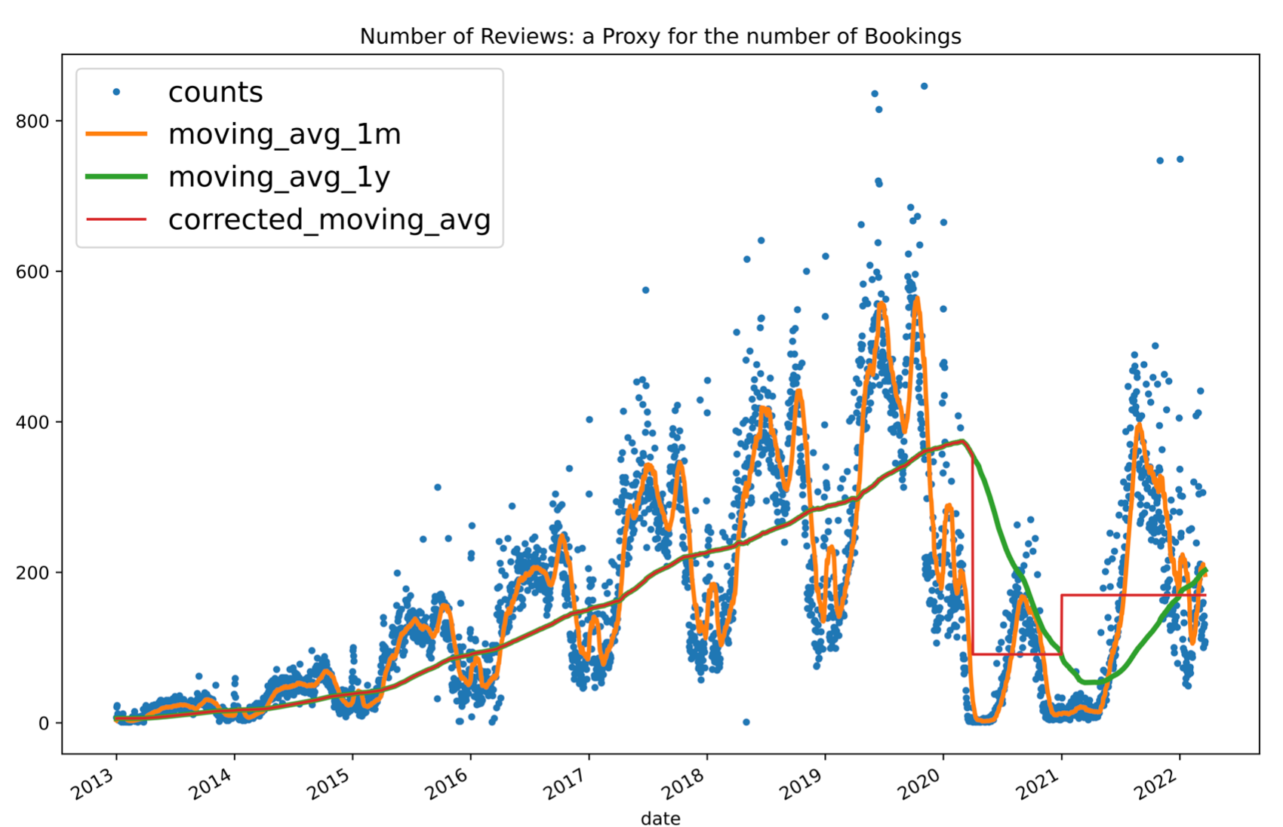
Review_dates.csv
group by ‘date’ and count
compute 1 month and 1 year moving average
Notes:
Number of reviews as a proxy for
Now we are working in the sandbox environment, so we are using pandas built in methods .groupby() and .rolling().
In the production phase the Airbnb reviews dataset (even of the whole world, if needed) would be saved in Hadoop File System, and these operations would be carried out by MapReduce jobs.

Slide 7
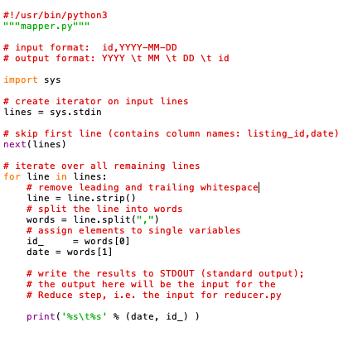
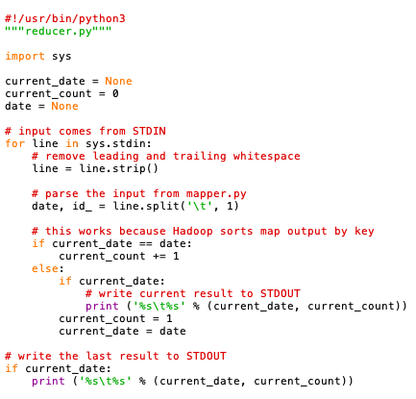
Group ‘reviews’ by ‘dates’ with Hadoop MapReduce
INPUT: reviews.csv
mapper.py
reducer.py
shuffling
sort stdin
OUTPUT: date (YYYY-MM-DD) \t counts (number of reviews).
Notes:
INPUT: reviews.csv (potentially contains every AirBnb review ever written)
MapReduce steps:
SPLITTING: we split the input file into small blocks and send them to mapping nodes via standard input;
MAPPING: in parallel, transforms the reviews dataset to be easily analyzed: the output are intermediate key-value pairs (<date, review_id>).
SHUFFLING: sort the mappers output by ‘date’, and combine key-value pairs with the same key. Feed each reducing node with a group of keys (dates).
REDUCING: in parallel, count the number of reviews for each key (date).
OUTPUT: date (YYYY-MM-DD) \t counts (number of reviews). It is obtained merging the outputs of all reducers.

Slide 8
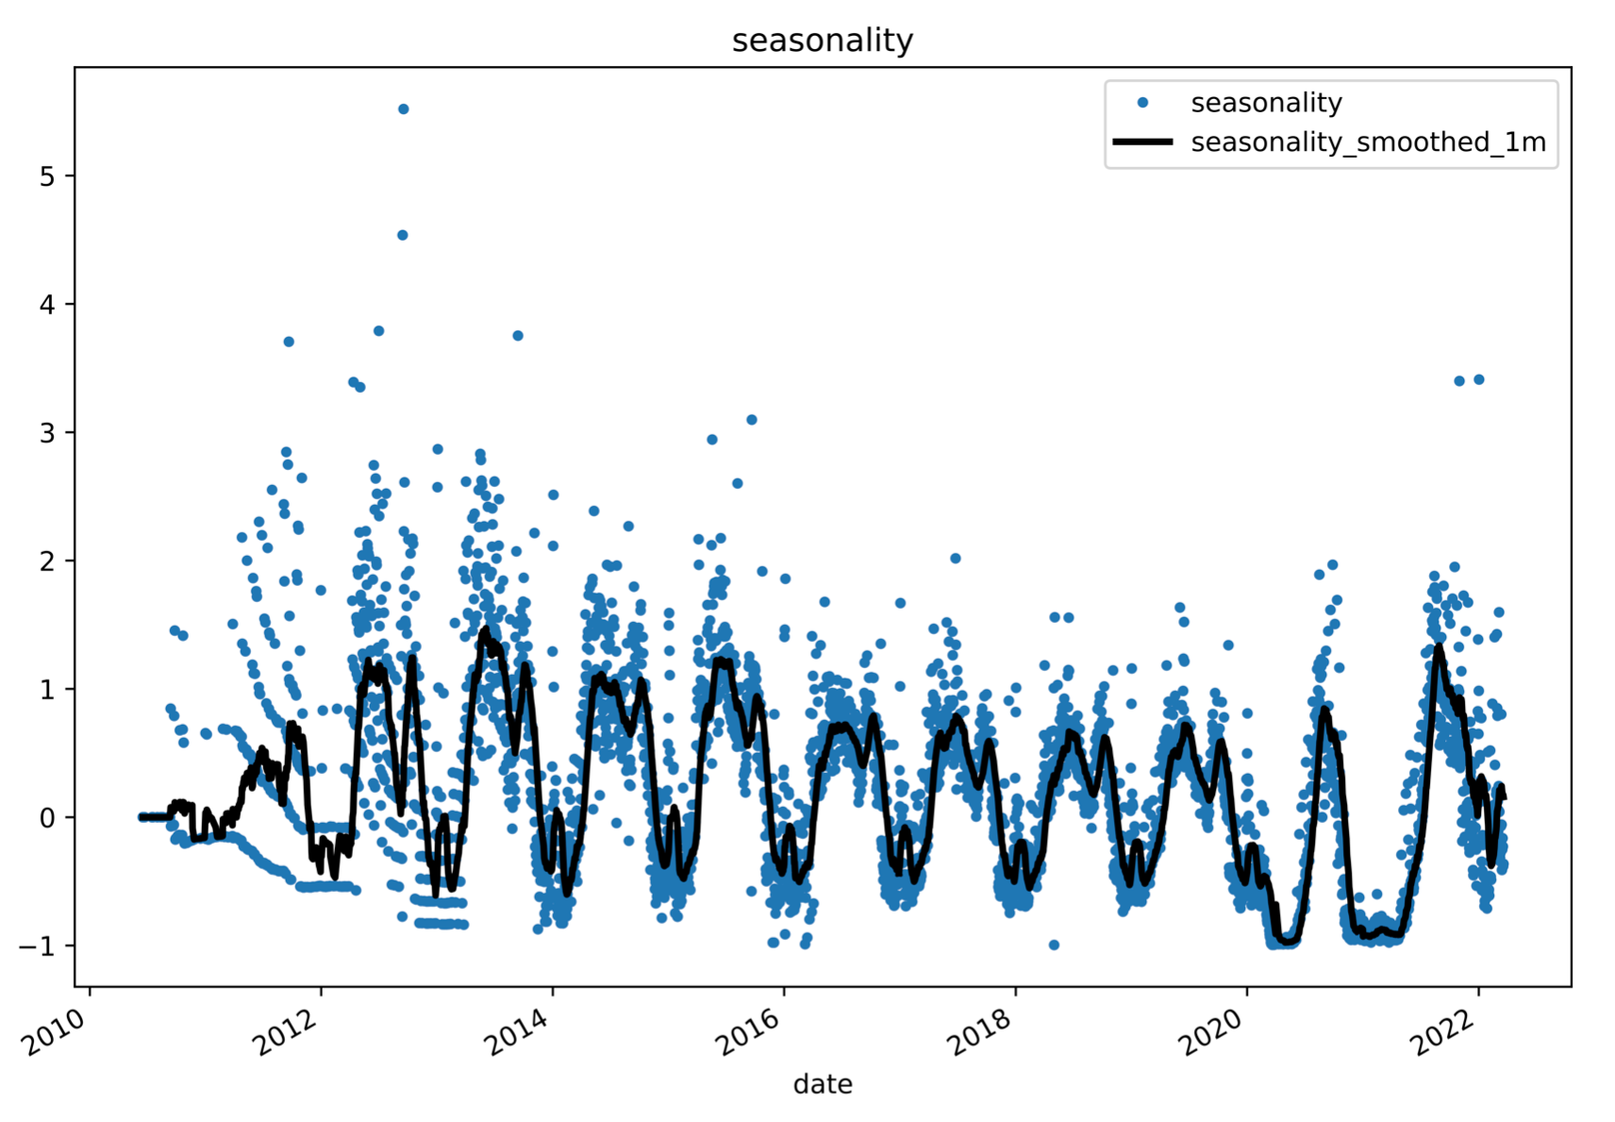
Hypothesis H1
H1: The number of bookings depends on the day of the year.
Custom metric: seasonality = (counts - moving_avg_1y)/moving_avg_1y
H1 is equivalent to: seasonality in each day of the year is highly correlated between different years.
Notes:
NOTE: the first formulation of H1 is very intuitive, but not immediately verifiable. The second formulation, instead, is directly verifiable on our data.

Slide 9
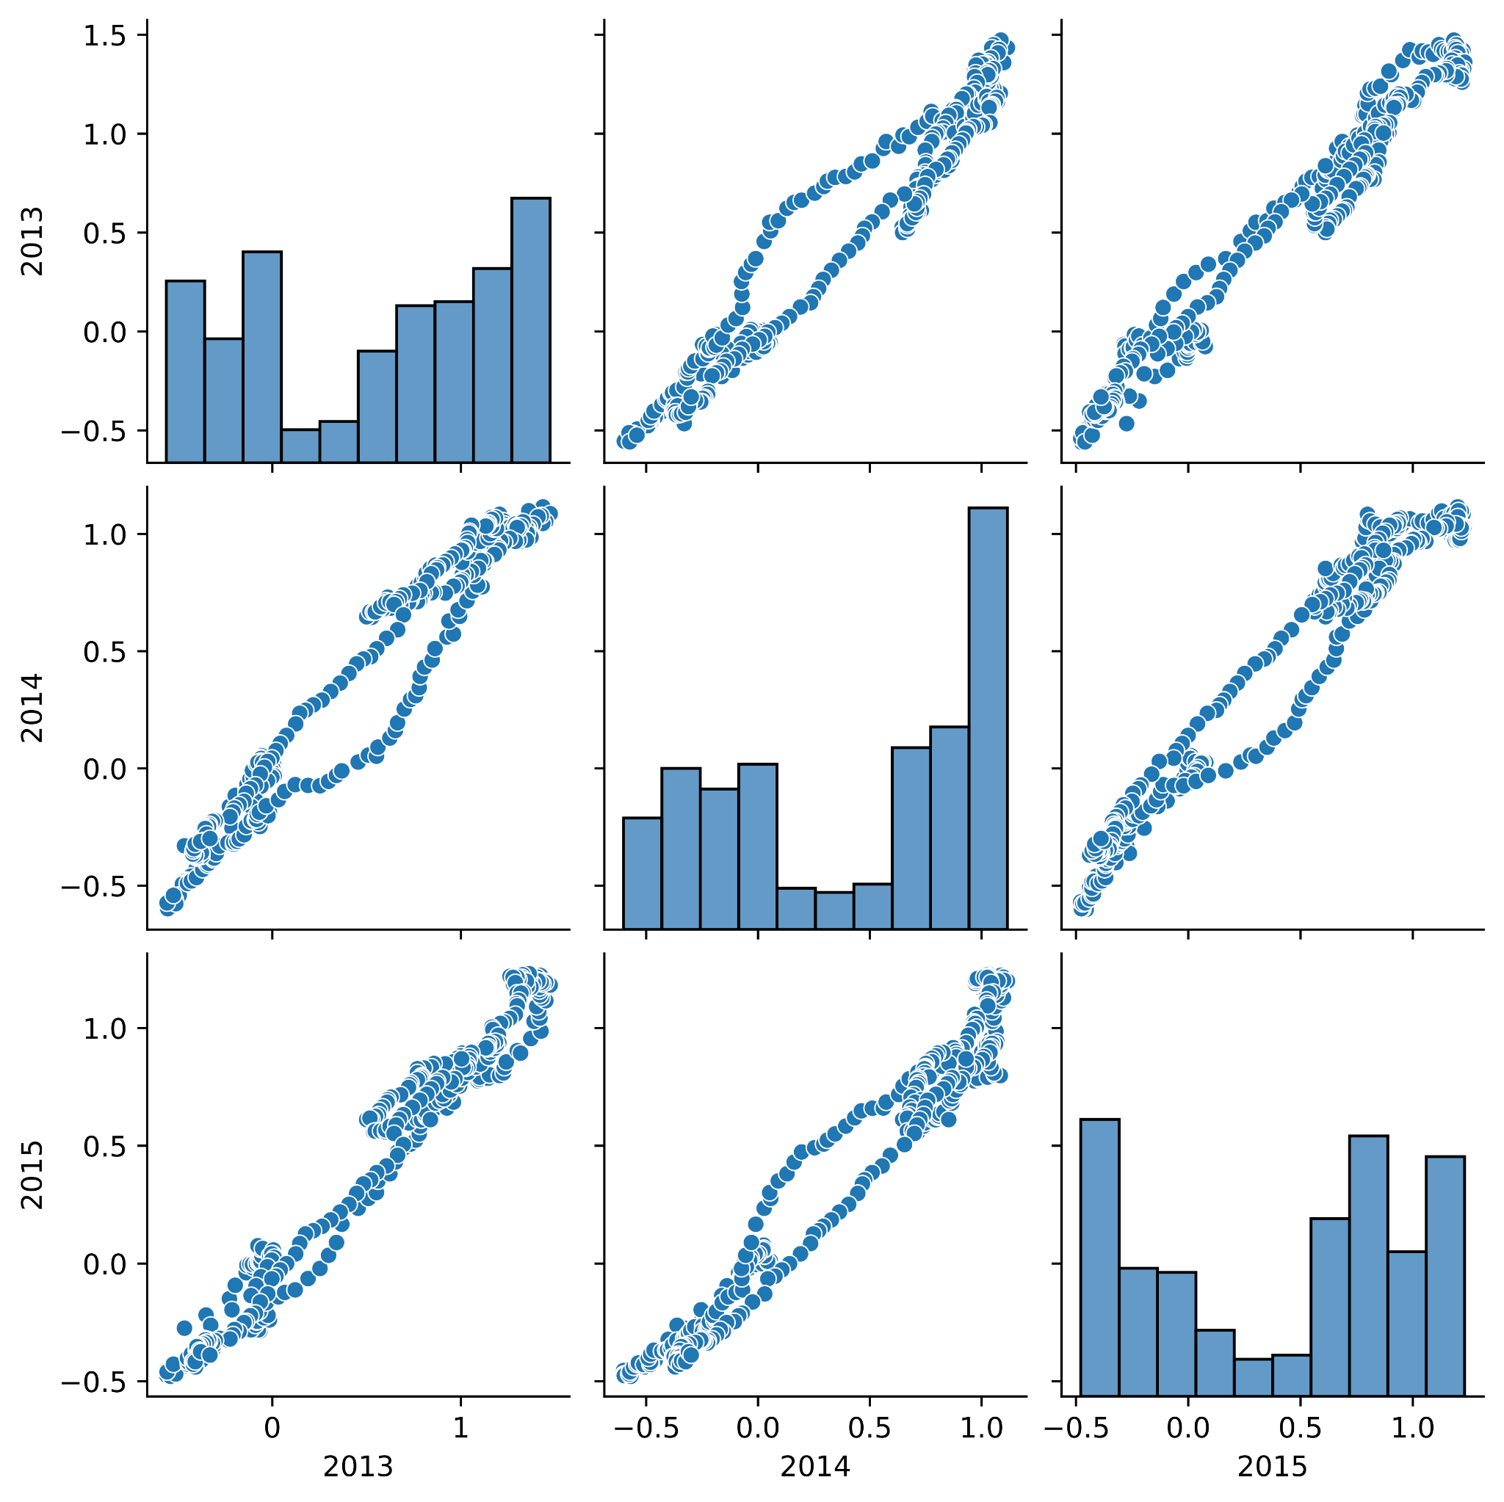
Data reshape and normality check for H1 testing
Data reshape: pivot of the DataFrame, with index = ‘day_of_year’, columns = ‘year’, values= 'seasonality_smoothed_1m'.
The data are not normally distributed. So to validate H1 we used the Spearman correlation test.

Slide 10
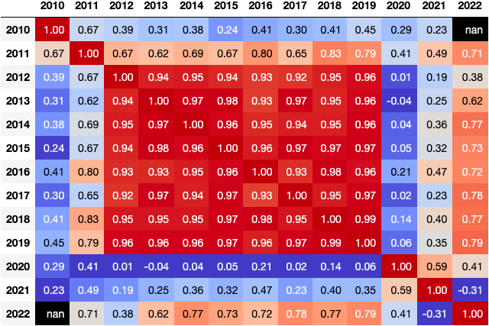
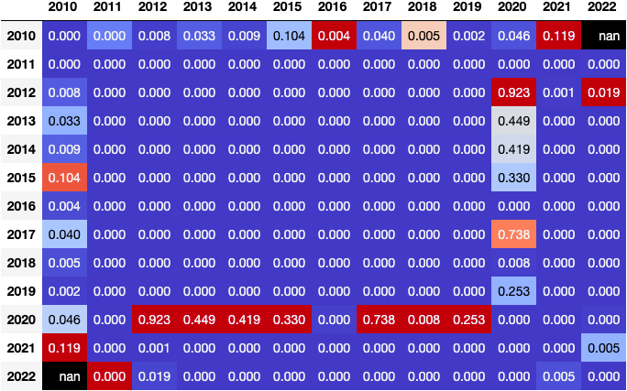
Spearman correlations and p_values
Correlations
p_values
H1 is true for years 2012-2019, but false for the other years.
Notes:
We fixed the statistically significance threshold at p=0.01 (1% probability of having obtained a greater or equal correlation by chance: i.e. if the distribution were uncorrelated)
The correlation coefficients across years 2012-2019 are all greater than 0.9, with p_values well below the threshold of p=0.01. It means that H1 is true for those years.
The remaining years are:
2010-2011: here the lack of a clear seasonal pattern can be attributed to the fact that the AirBnb platform just started its operations in this city, and thus the seasonality was not predominant, in confront to other random patterns. H0 is false when relating 2010 and 2011 to any other year.
2020-2022: as previously mentioned, here the seasality was disrupted by covid, so in 2020 the correlation is lost (H0 is false), in 2021 and 2022, and in 2021 and 2022 it is partially recovered. If we look at the seasonality graph we better understand this result. We can see that in 2020 we have a big central peak, comparable to the one from previous years, but we lost all the remaining information that was contained in the small bumps, which are partially recovered in 2021 and especially in 2022.

Slide 11
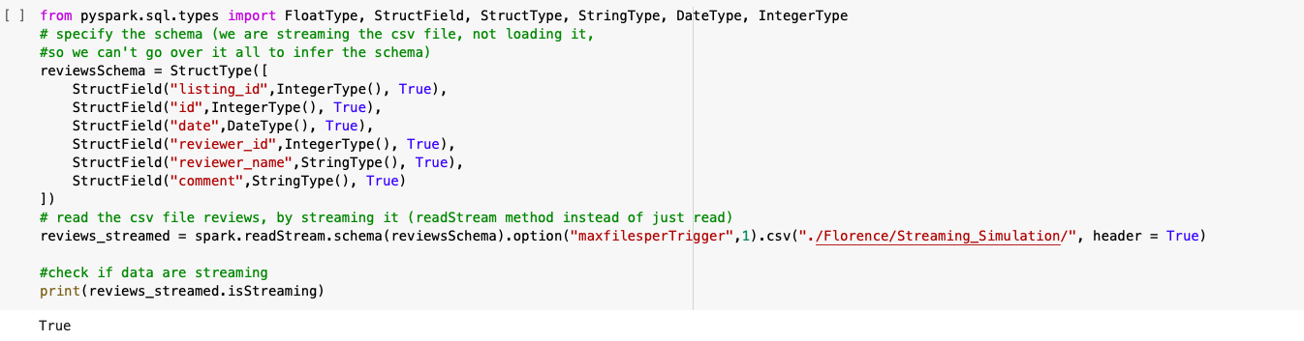
Scalability - Control of the streaming source
We simulated streaming source, using Spark Streaming
We streamed a directory of csv files. We can deal with any other streaming source (TCP port, Kafka, ecc. ) in the same way.

Slide 12
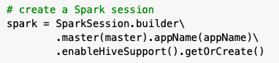

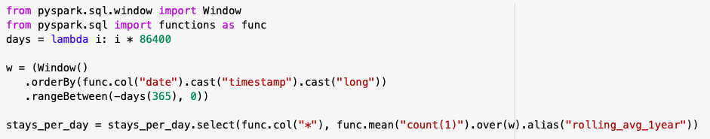
Scaling to the Big Dataset
Exploit the data warehouse we built with hive tables.
Group reviews by date
Compute 1 year (and 1 month) moving average

Slide 13


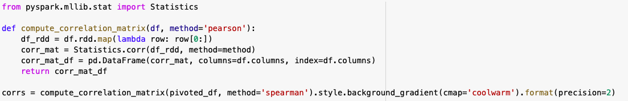
Scaling to the Big Dataset
Compute seasonality
Pivot the dataframe
Compute the correlation matrix
Notes:
So we built a pipeline of queries and tranformations that would allow us to validate our hypothesis in a Big Data Scenario.
We didn’t have at our disposal the Big Data of this scenario, and we didn’t have the computational power needed so that spark really becomes necessary, so we didn’t get any new result from this pipeline, However it is ready to be applied for the scenario where we have those instruments at our disposal.

Slide 14
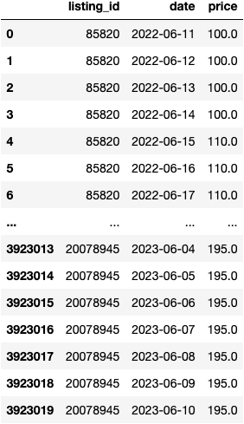
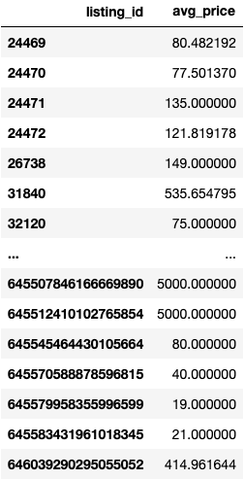
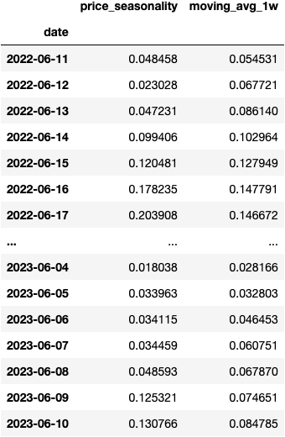
Calendar.csv - Price seasonality
avg_price =
rel_price =
group price by listing_id and average
(price - avg_price) / avg_price
price_ seasonality =
group rel_price by date and average

Slide 15
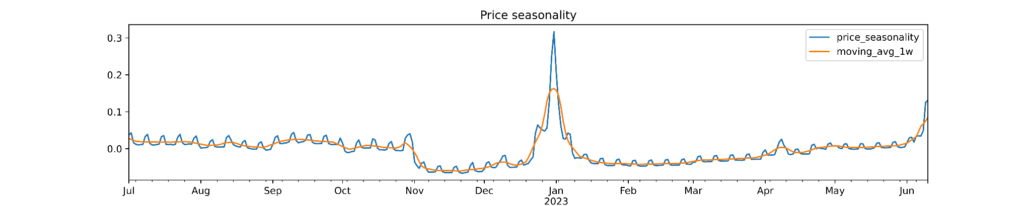
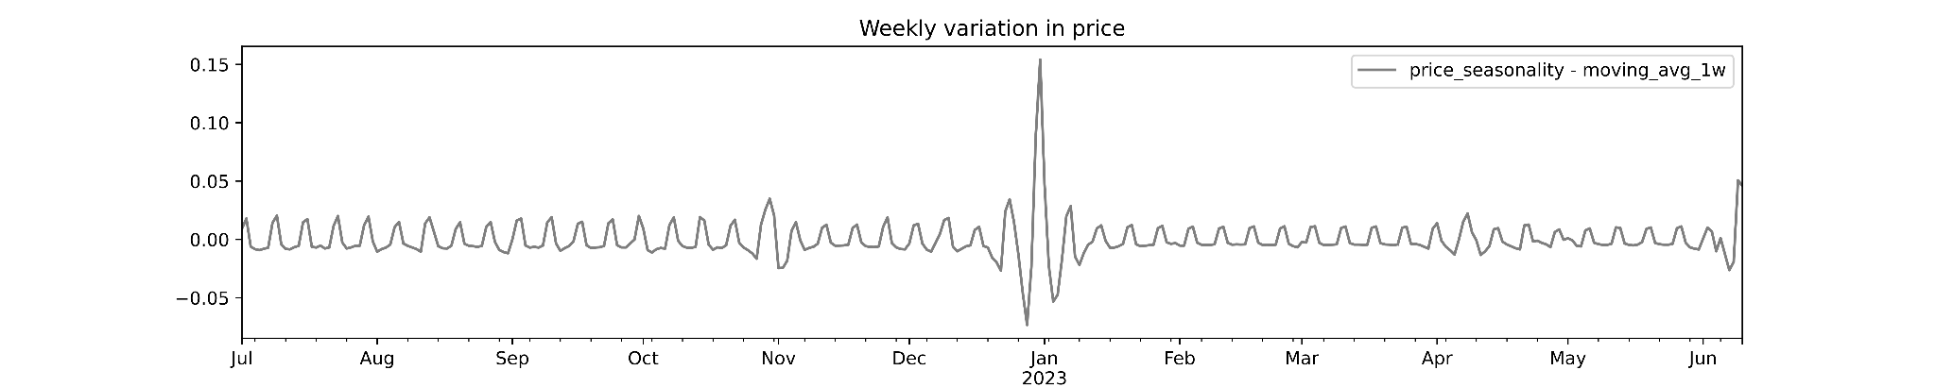
Price seasonality
Notes:
We see a big peak in the price seasonality in January 2023, probably due to the New Year festivities. We don’t see any apparent correlation with the bookings_seasonality metric that we defined before.
But we see also a very consistent TREND, with a period of 1 week. So we formulate the hypothesis that the prices are higher in the weekend.

Slide 16
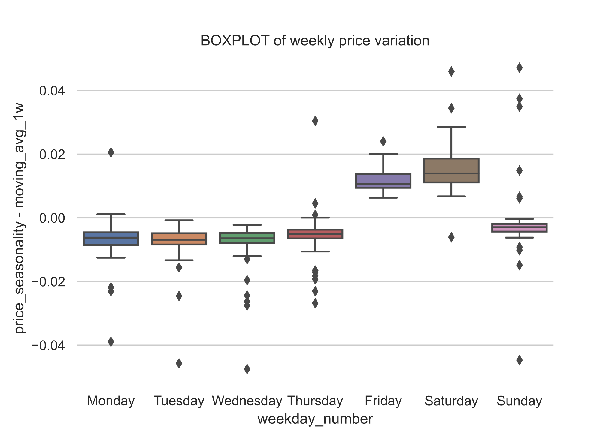
Hypothesis H2
H2: the prices are higher in the weekend.
To validate H2, we simply created a boxplot, grouping the price seasonality metric by the day of week.
Apart from few outlings, all the prices on Fridays and Saturdays are greater than on other days.
H2 is true.

Slide 17
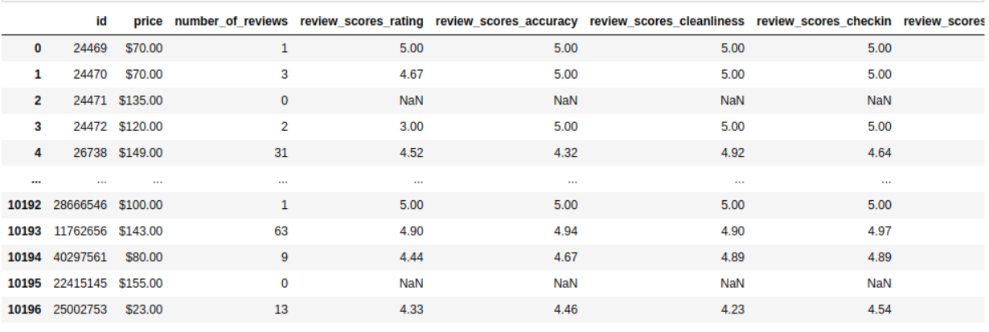
Listings.csv

Slide 18
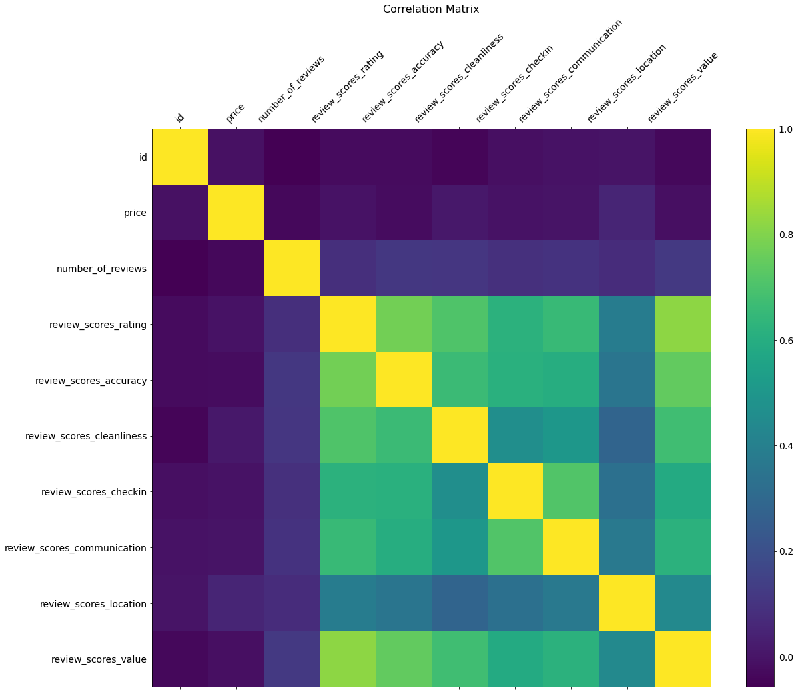
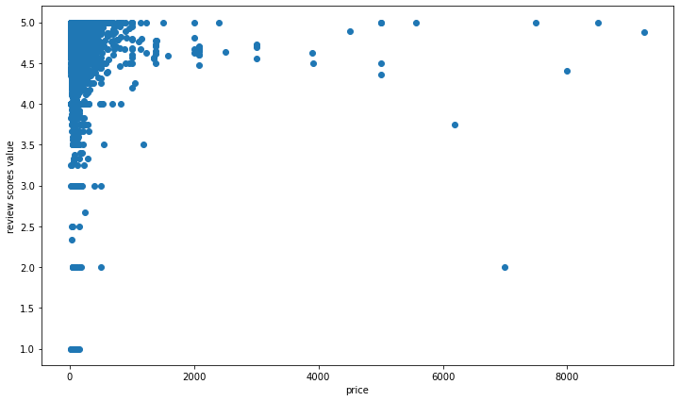
Hypothesis H3
H3: there is a direct relationship between the price and review scores.

Slide 19
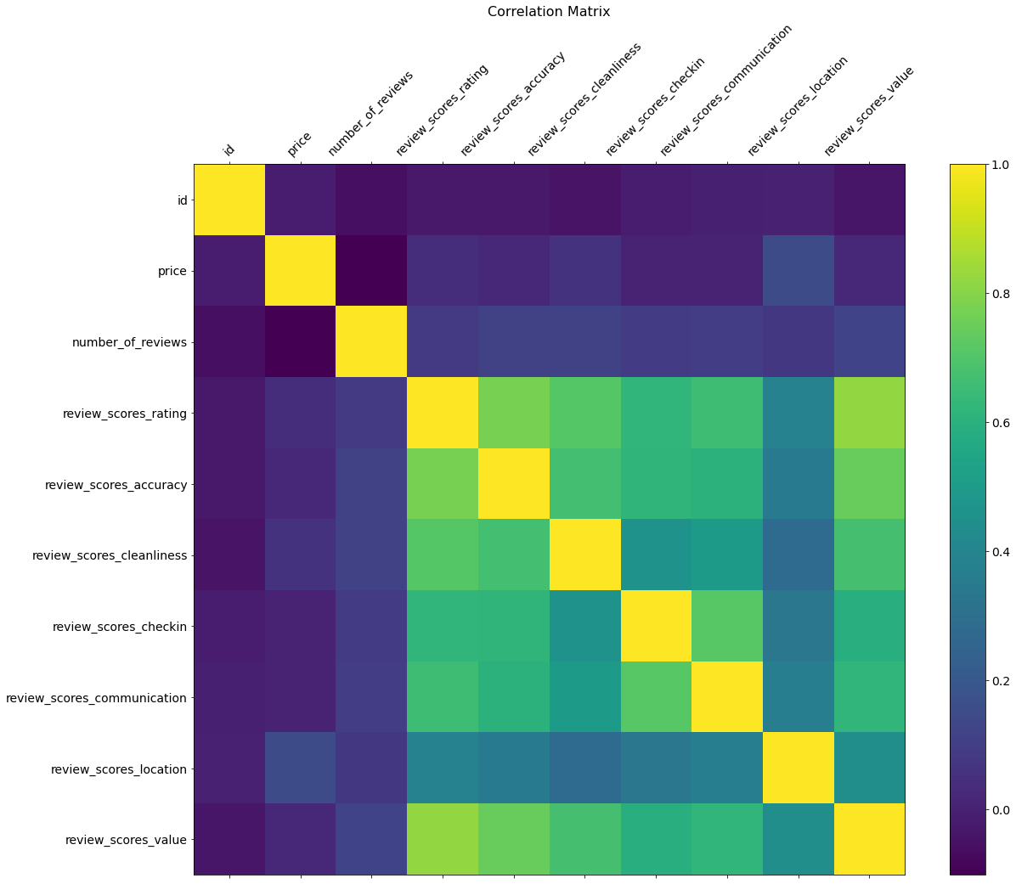
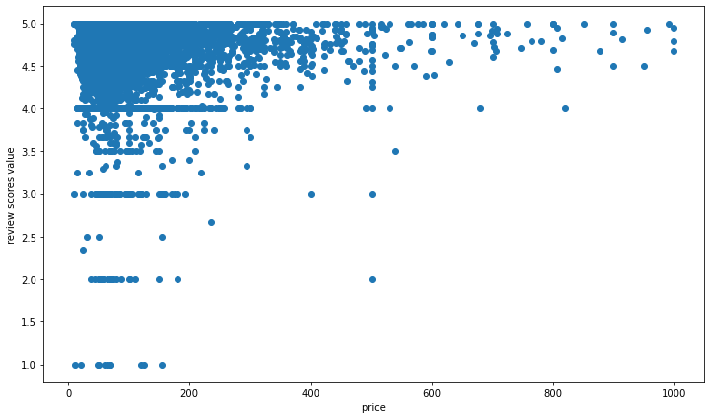
Hypothesis H3
H3: there is a direct relationship between the price and review scores.

Slide 20
Hypothesis H3
H3: there is a direct relationship between the price and review scores.
H3 is false.
Generally, we can say that the initial hypothesis is 'False'.
But, we can extract some other interesting result from above correlation matrix visualization. it can be seen that the price is somehow more correlated with the location and cleanliness scores.

Slide 21

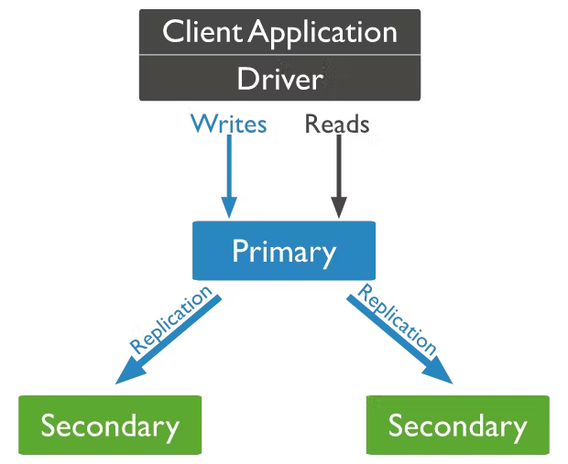
MongoDB Atlas Clusters provide horizontal scaling, where data is distributed across many servers. [1]

Slide 22
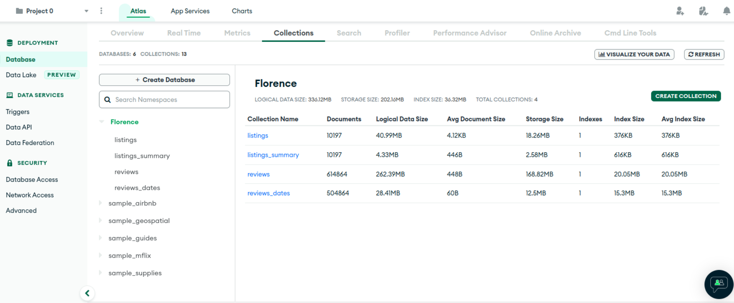
MongoDB Atlas provides an easy way to host and manage your data in the cloud

Slide 23
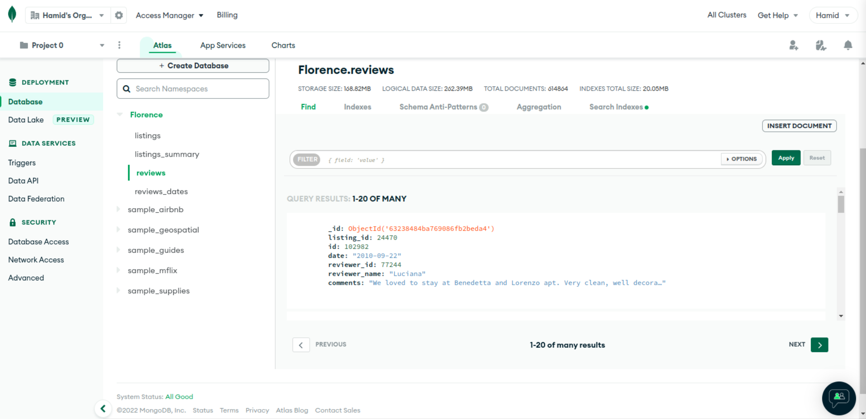
MongoDB Atlas provides an easy way to host and manage your data in the cloud

Slide 24
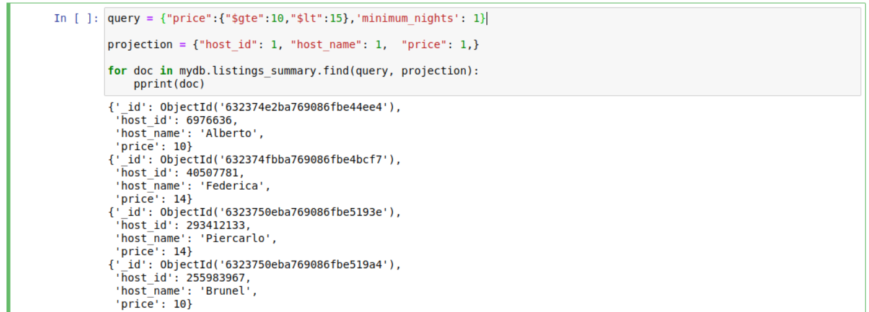
Mongodb Query sample

Slide 25

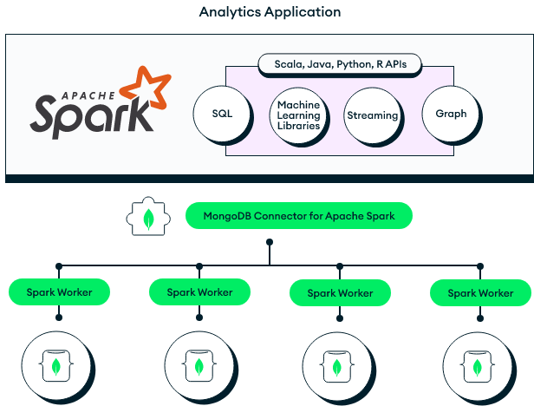

Slide 26
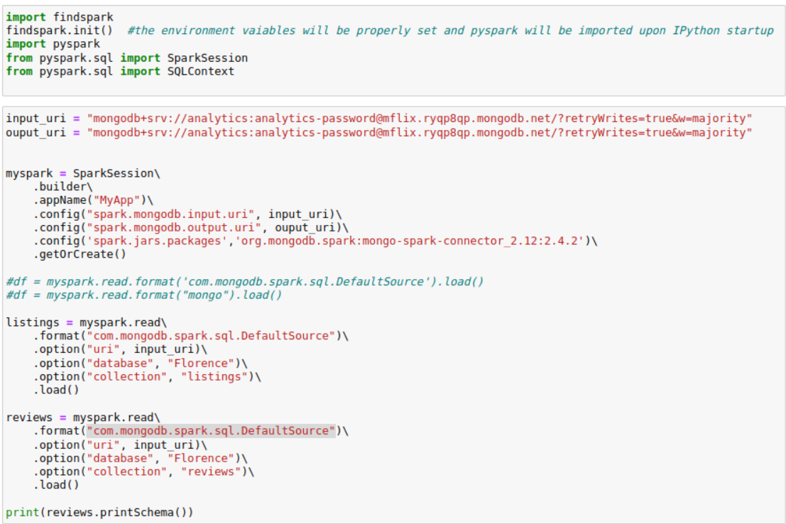
Spark Mongodb Connector

Slide 27
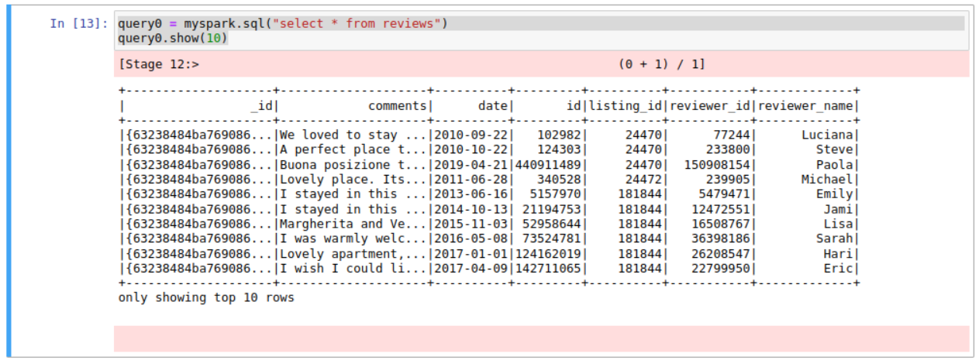
SQL Queries in Spark

Slide 28
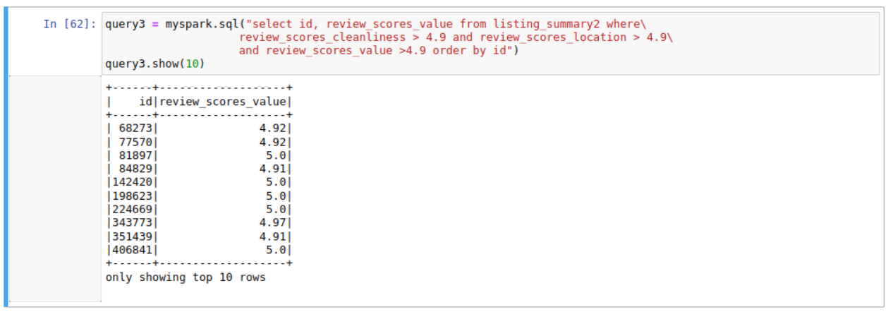
SQL Queries in Spark

Slide 29
Future work suggestions
Create another sandbox and repeat a complete analysis for a second city (e.g. Rome)
Using NLP methods, perform text analysis (such as sentiment analysis) on reviews data
Study the relationship between the files we had in the dataset (joining them)

Slide 30
Conclusions
We:
analysed Airbnb Florence data
performed standard python analysis in the Sandbox
built a Framework to scale our findings to a Big Data Scenario, using:
Spark Streaming: control the source
MongoDB: first project repository → data lake
Pymongo and Atlas: real time data query
Spark-MongoDB connector: data warehouse on top of hive
Spark sql and DataFrame: validation of hypothesis on whole dataset
Notes:
For the Big Data we focused on building the Architecture (framework) that would allows us to deal with the big data, rather than trying to obtain different results from the ones obtained in the sandbox (we don’t have neither such a big dataset, neither the computational power to exploit spark advantage over pandas)

Slide 31
References
[1] https://www.mongodb.com/basics/clusters
[2] https://www.analyticsvidhya.com/blog/2021/05/integration-of-python-with-hadoop-and-spark/

Slide 32

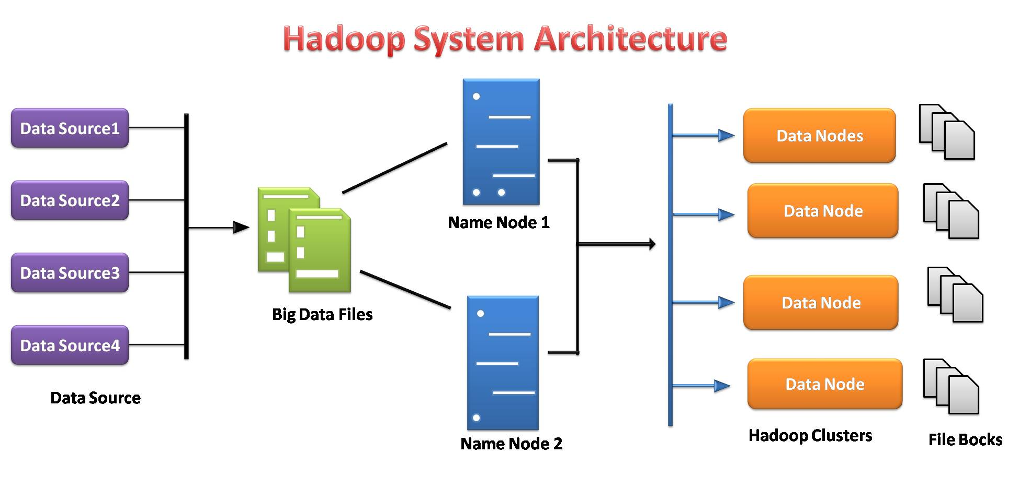
[2]

Slide 33
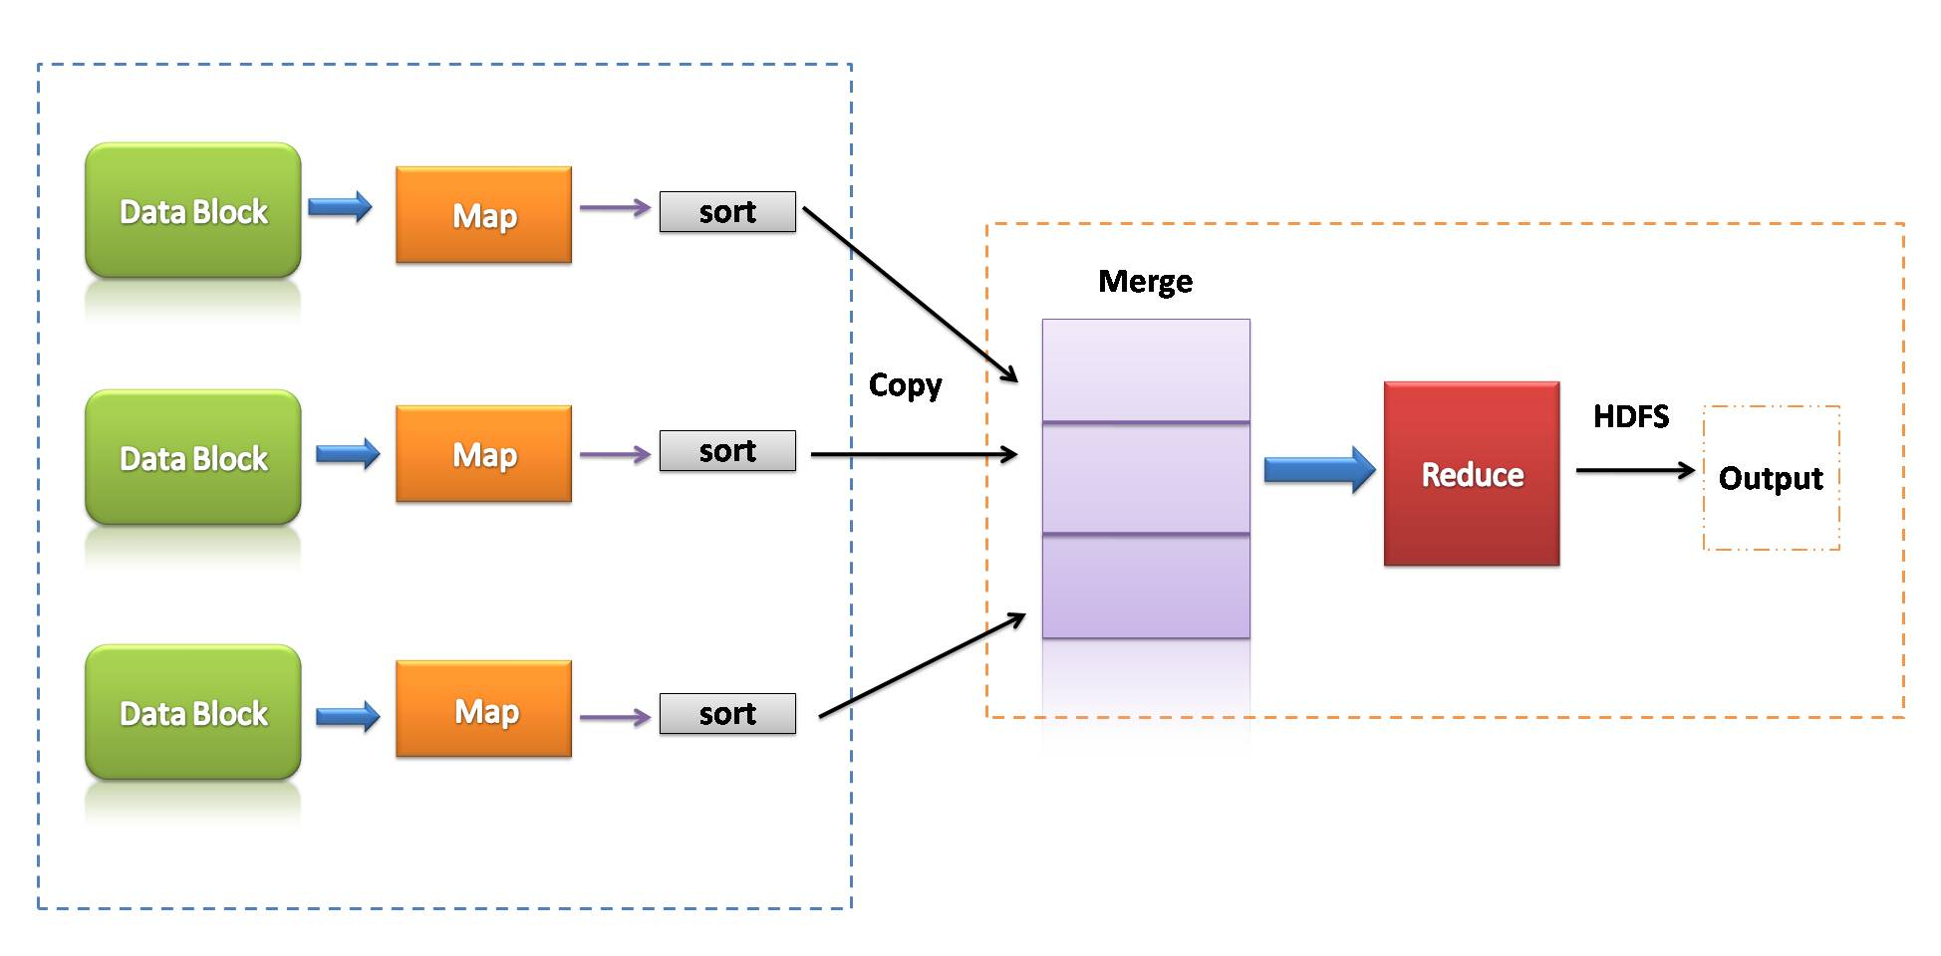
[2]

